Slide 1


AI FOR SE 2025
IELTS PRACTICE WEB APPLICATION

Slide 2



PHASE 1
CORE FEATURE
This feature was selected because it represents a critical part of the IELTSPhobic system — managing reading exams, submissions, and scoring, which directly impacts user assessment accuracy and experience.
ANALYSIS
This phase focuses on identifying all key public and business-logic methods that require testing, defining their purpose, inputs, outputs, dependencies, and edge cases to ensure comprehensive test coverage and reliability.

Slide 3

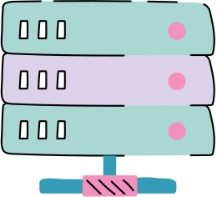
PHASE 1 : Core Feature Selection
Why choose Exam Module for AI Testing?
Contains diverse and interrelated sub-features (Reading, Writing, Listening).
Each sub-module has clear business logic — question delivery, submission, grading, and feedback.
Includes multiple dependencies (User, Exam, Attempt, OpenAI API, Repository).
Offers many edge cases for testing such as invalid answers, missing session data, or AI feedback errors.
Represents a real-world scenario of an online IELTS practice platform.

Slide 4
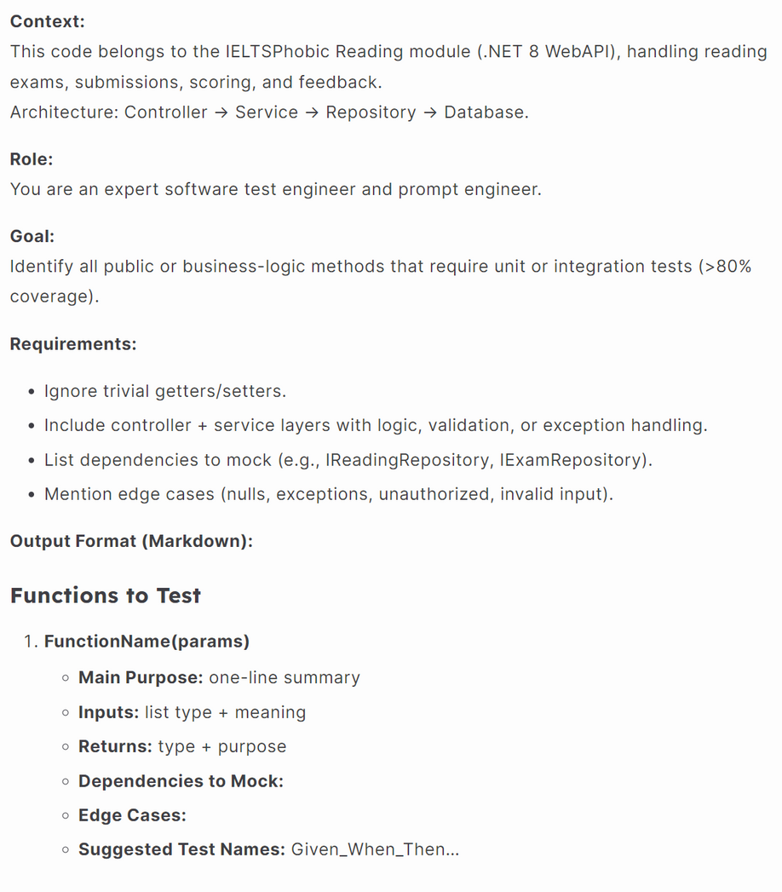
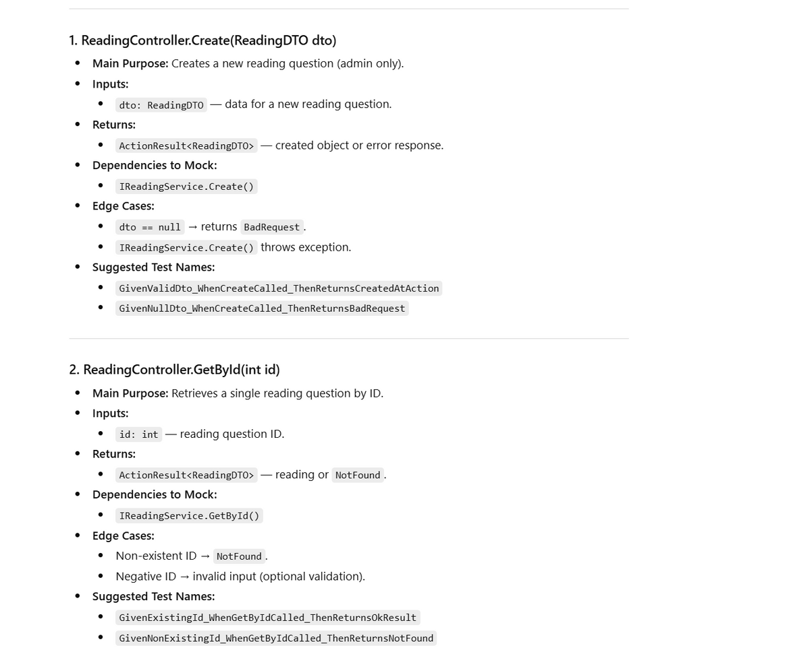

PHASE 1 : Analysis (READING)

Slide 5
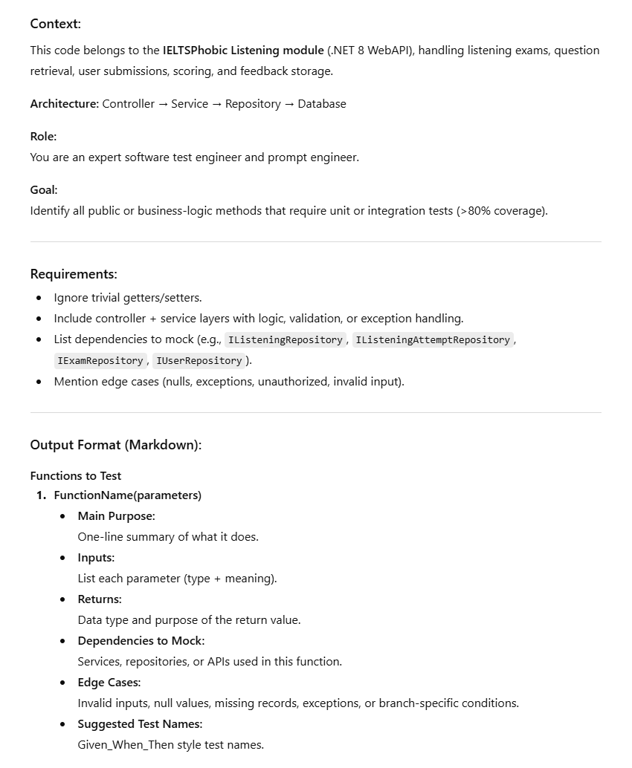
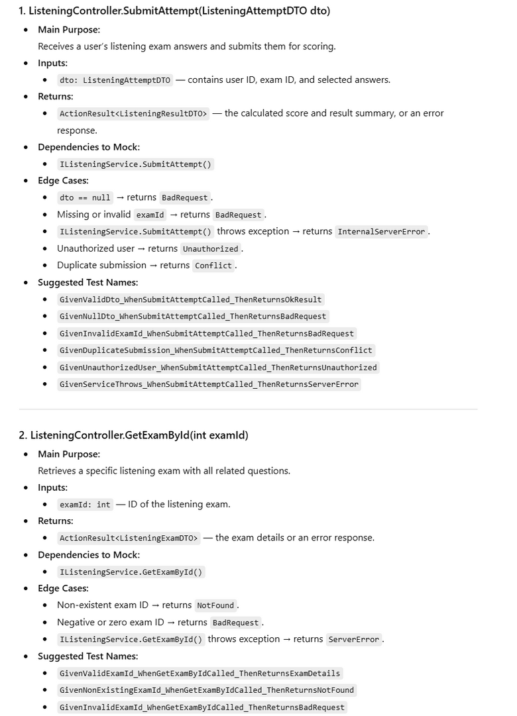
PHASE 1 : Analysis (LISTENING)

Slide 6
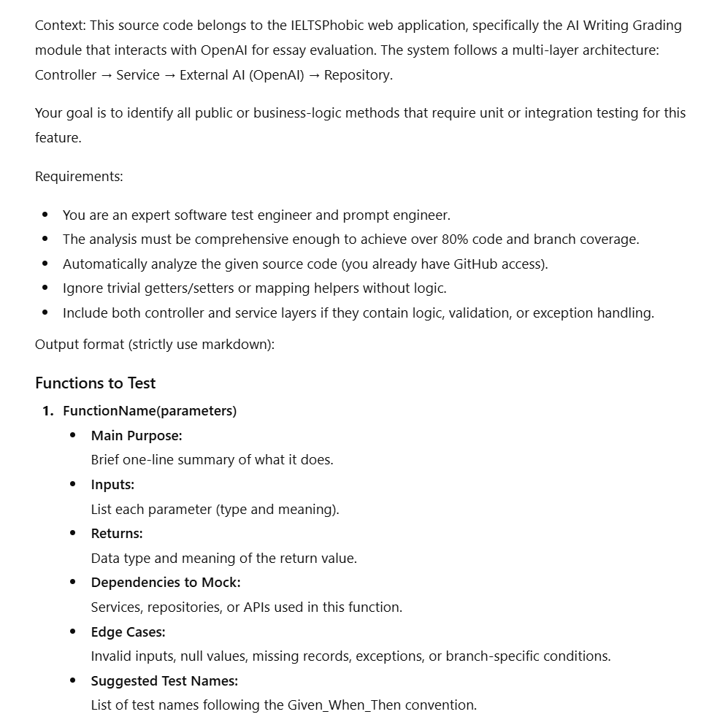
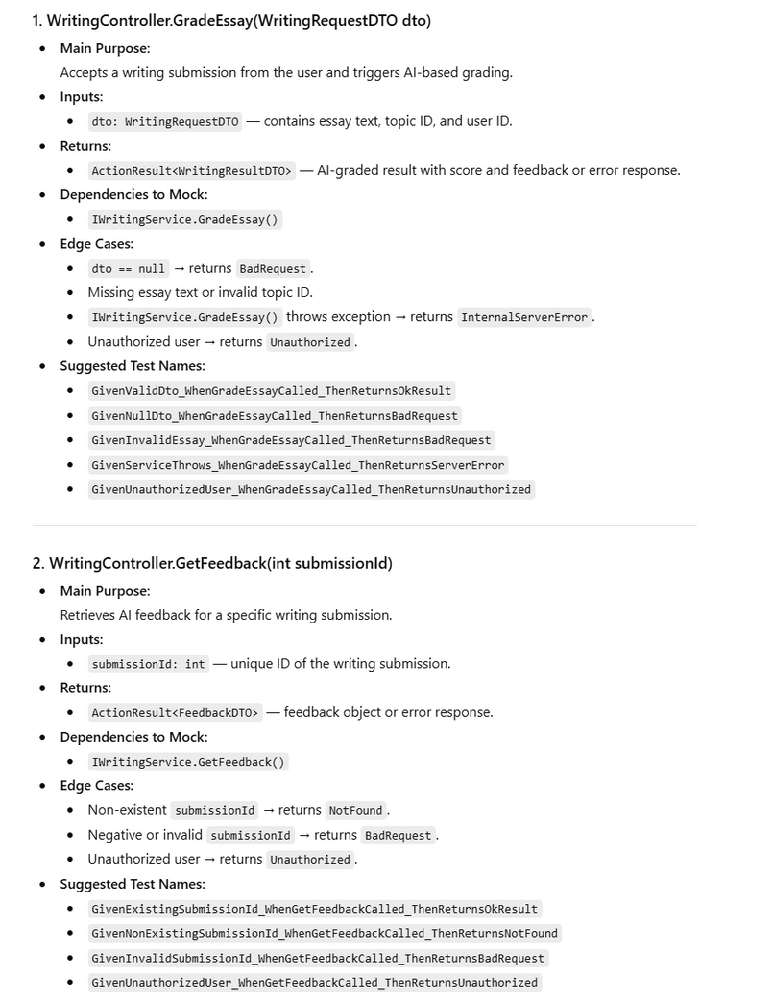
PHASE 1 : Analysis (Writing)

Slide 7
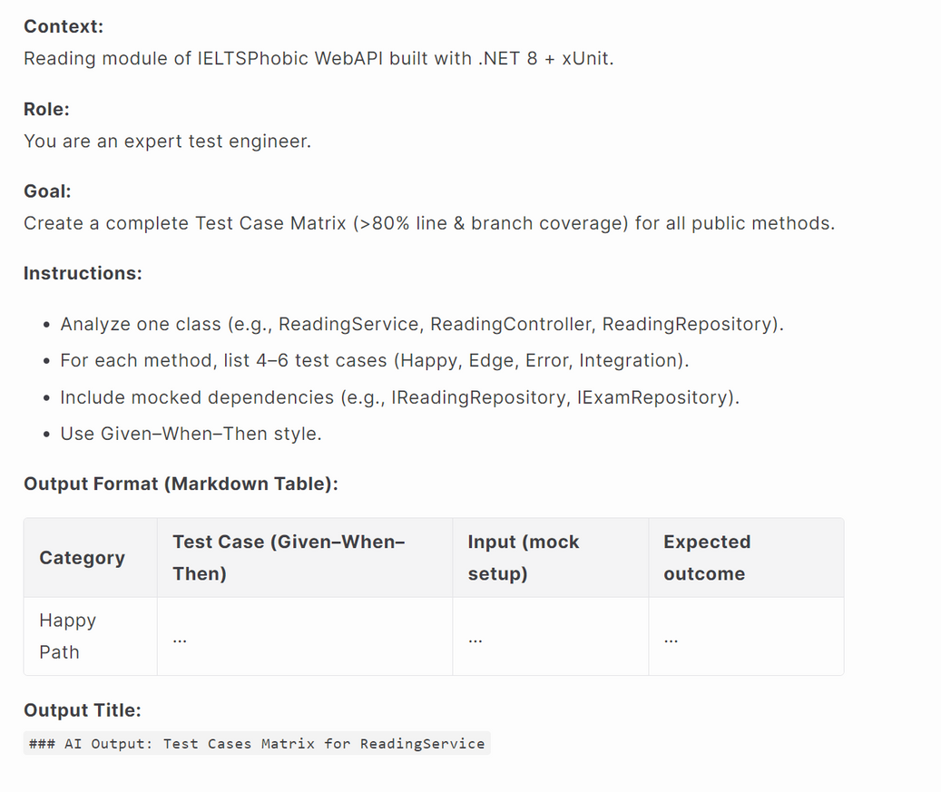
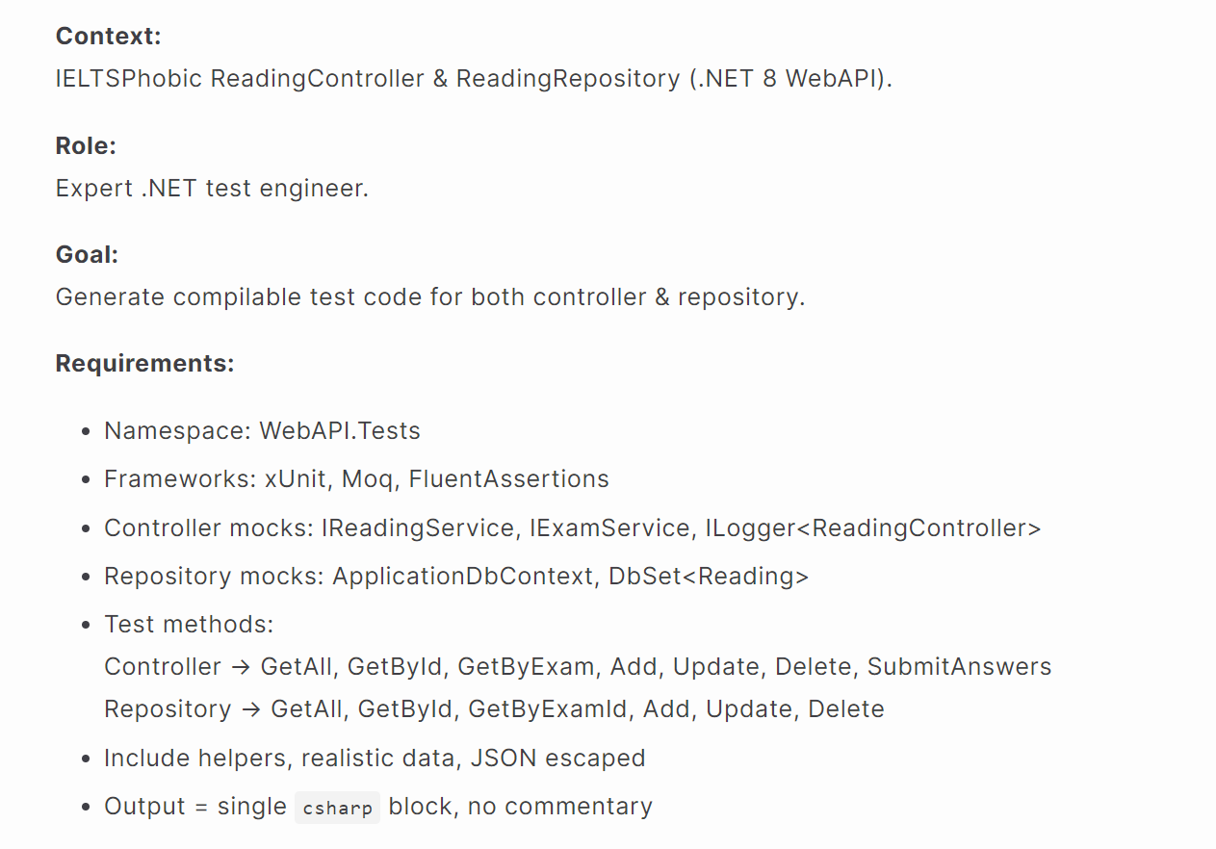
PHASE 2: TEST CASE DESIGN

Slide 8
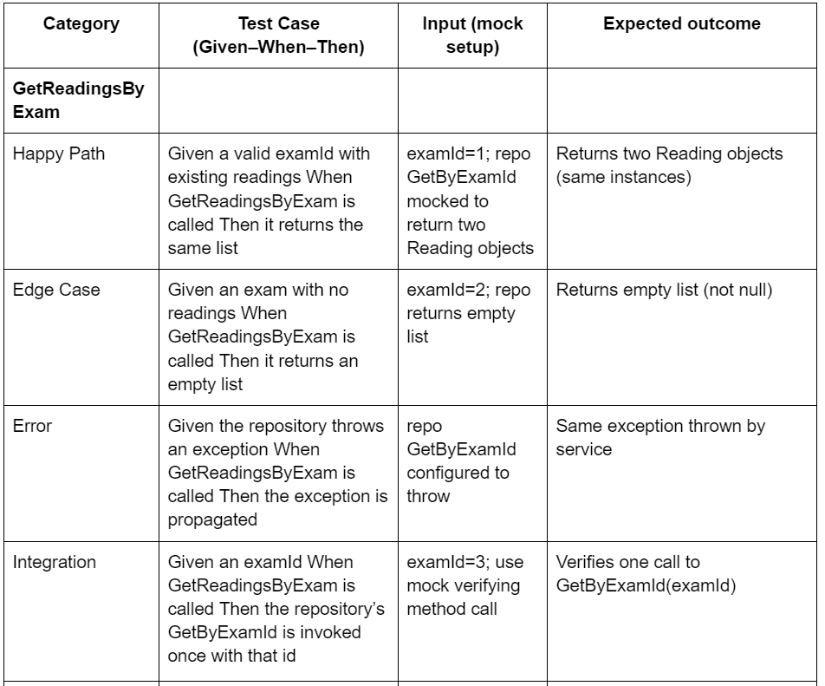
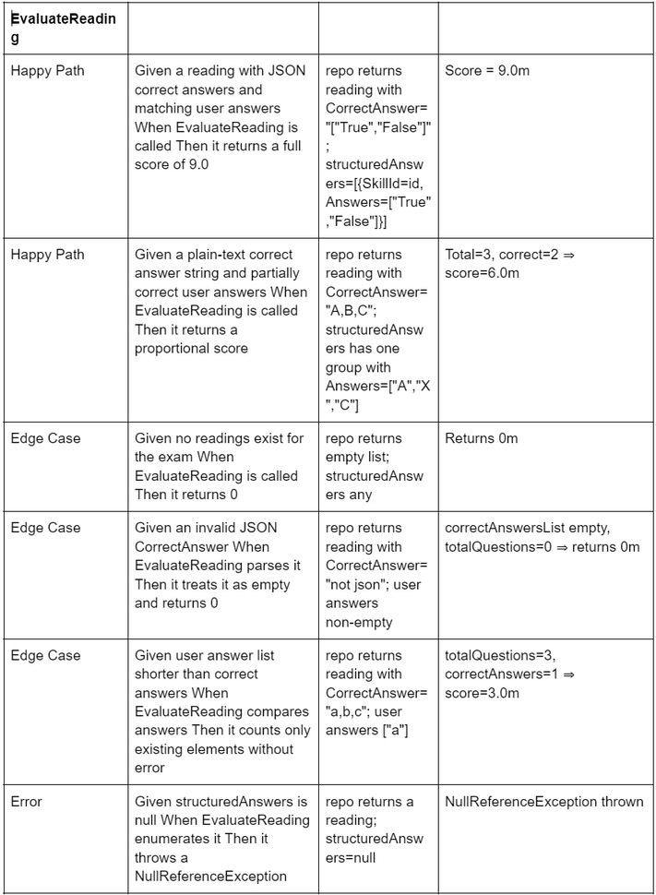
PHASE 2: TEST CASE DESIGN
AI OUTPUT For Reading Service

Slide 9
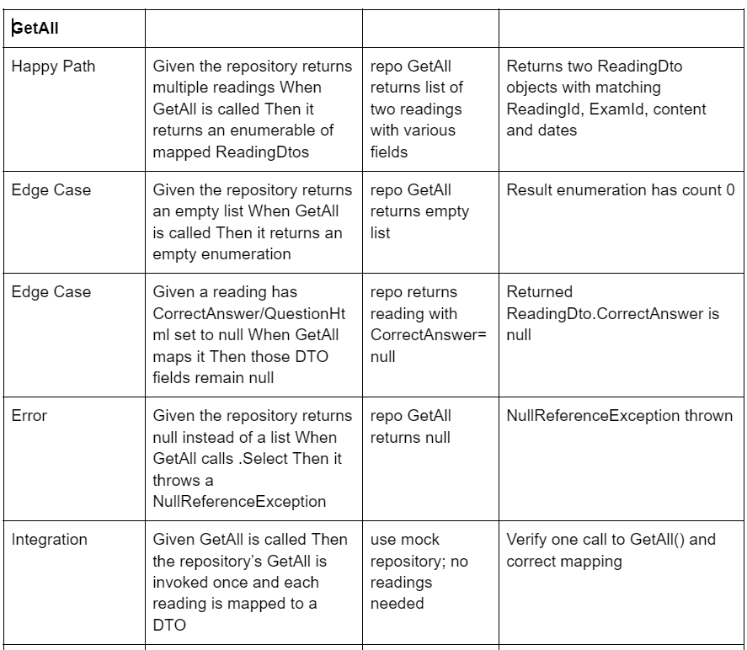
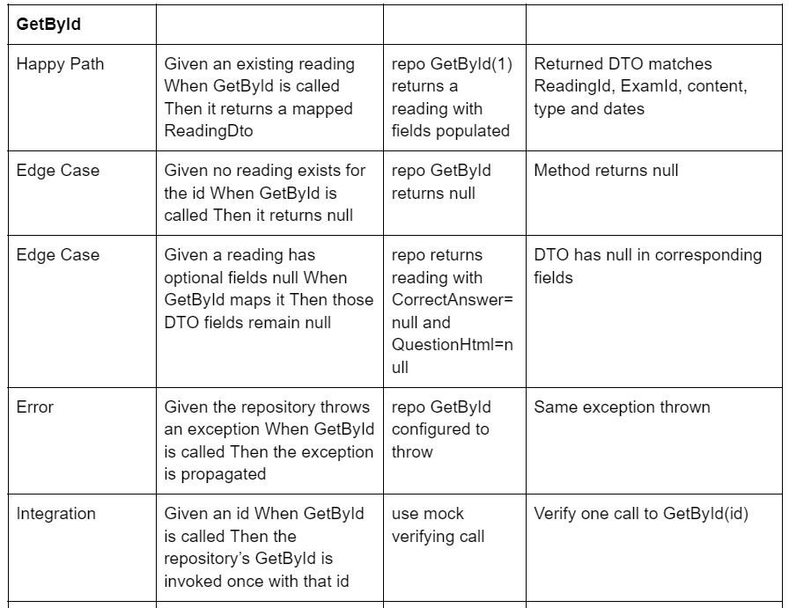
PHASE 2: TEST CASE DESIGN
AI OUTPUT For Reading Service

Slide 10
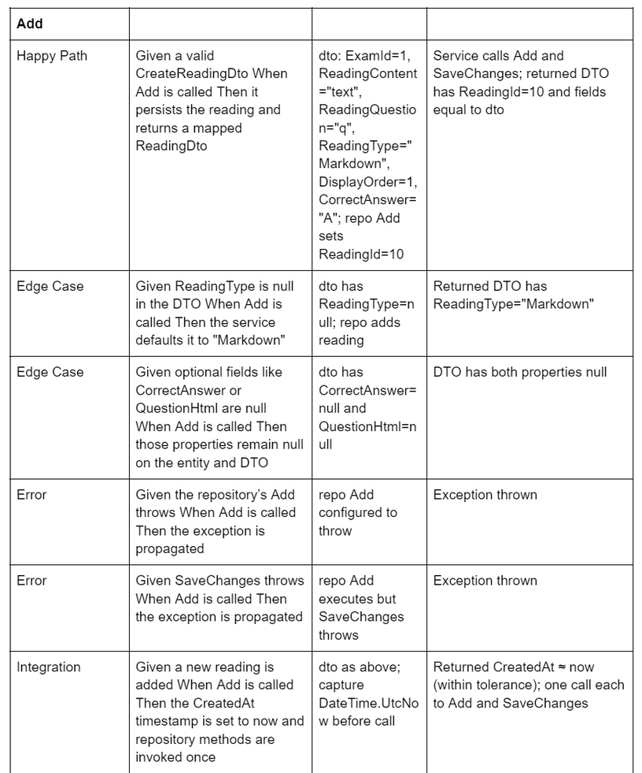
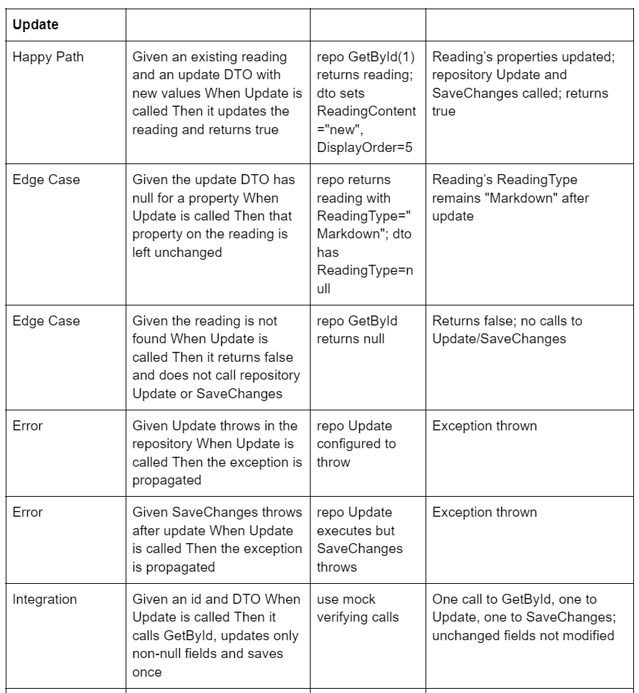
PHASE 2: TEST CASE DESIGN
AI OUTPUT For Reading Service

Slide 11
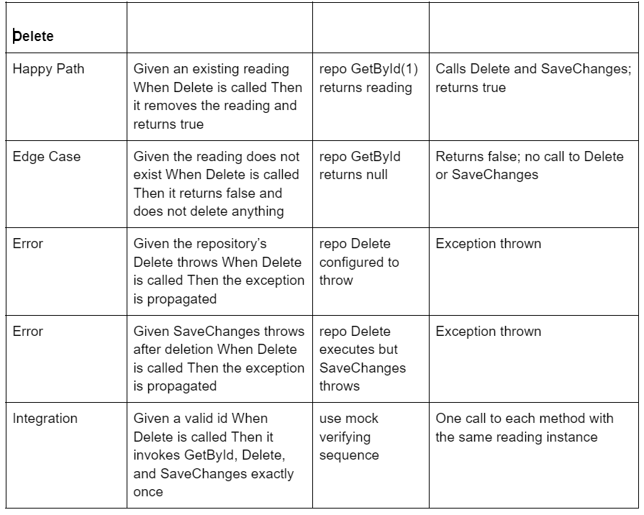
PHASE 2: TEST CASE DESIGN
AI OUTPUT For Reading Service

Slide 12
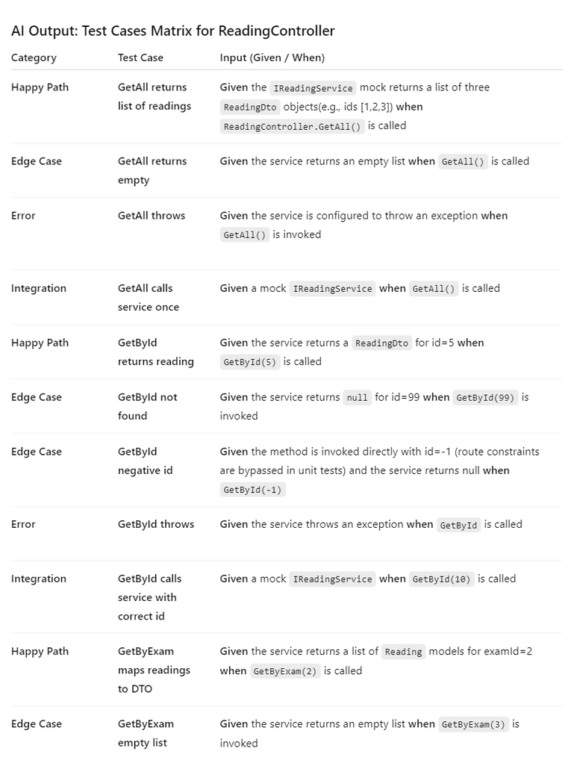
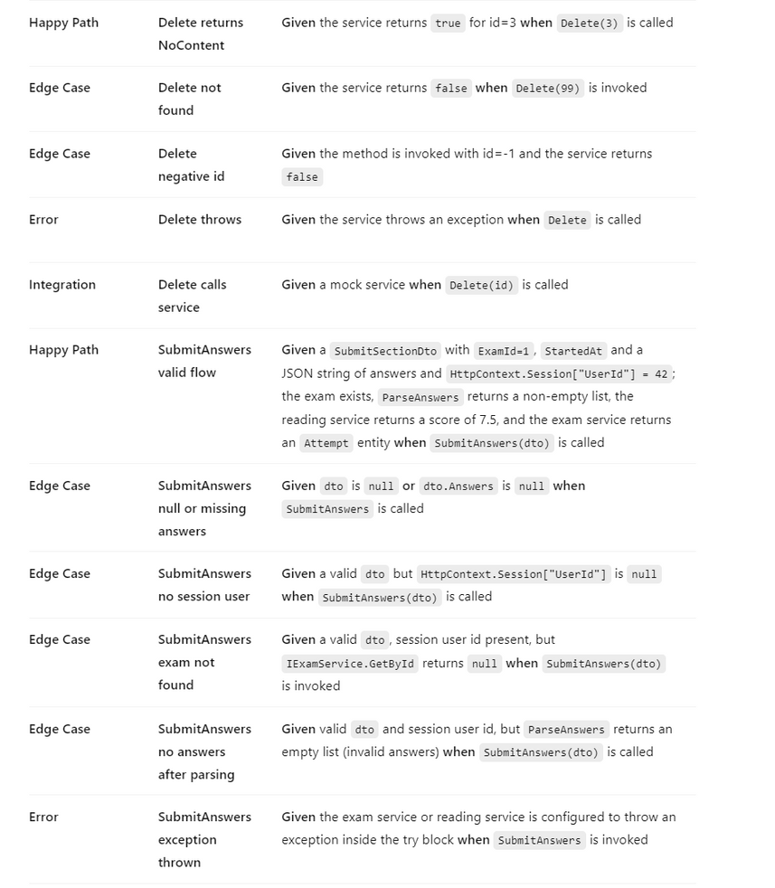
PHASE 2: TEST CASE DESIGN
AI OUTPUT For Reading Controller

Slide 13
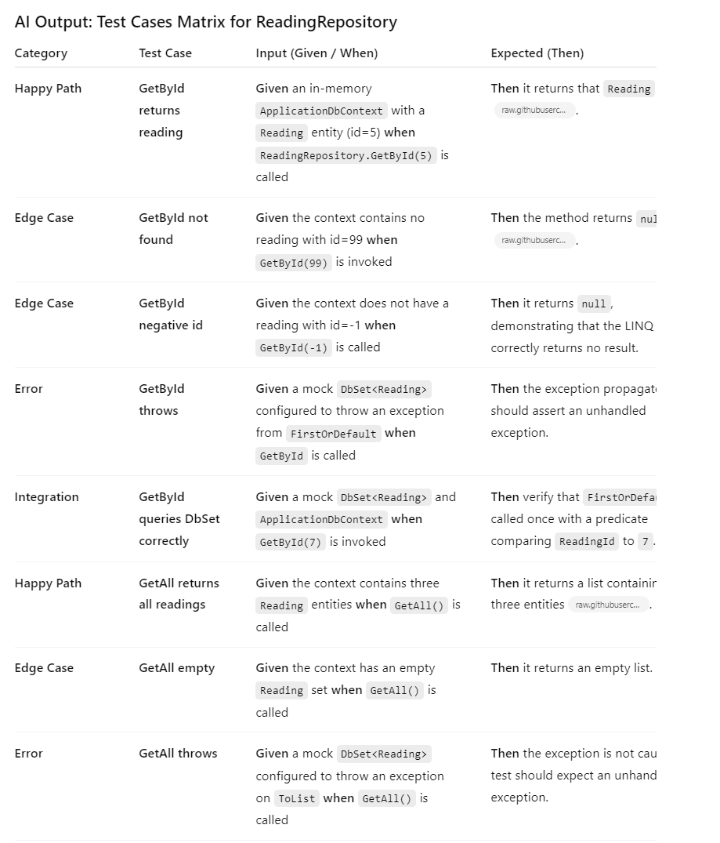
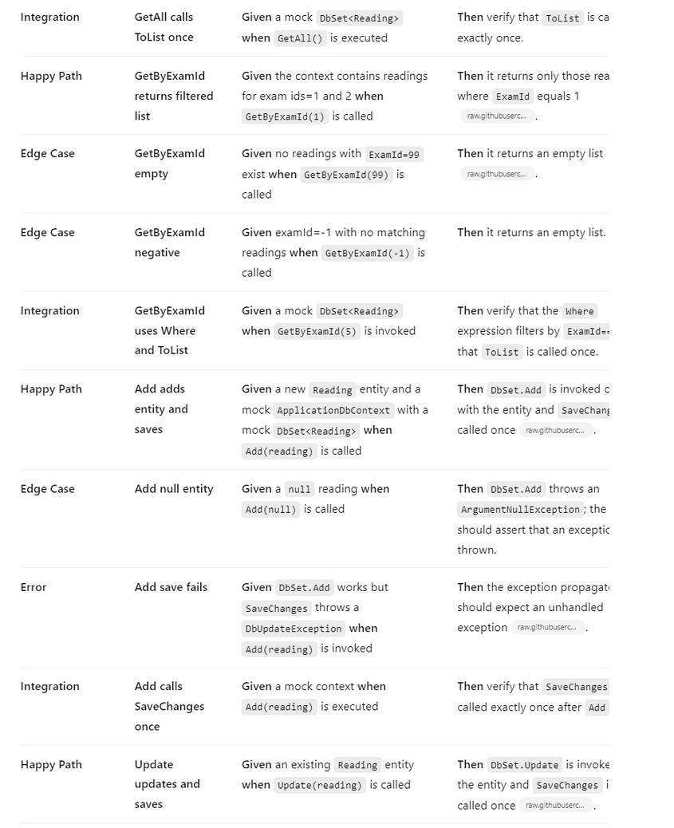
PHASE 2: TEST CASE DESIGN
AI OUTPUT For Reading Repository

Slide 14
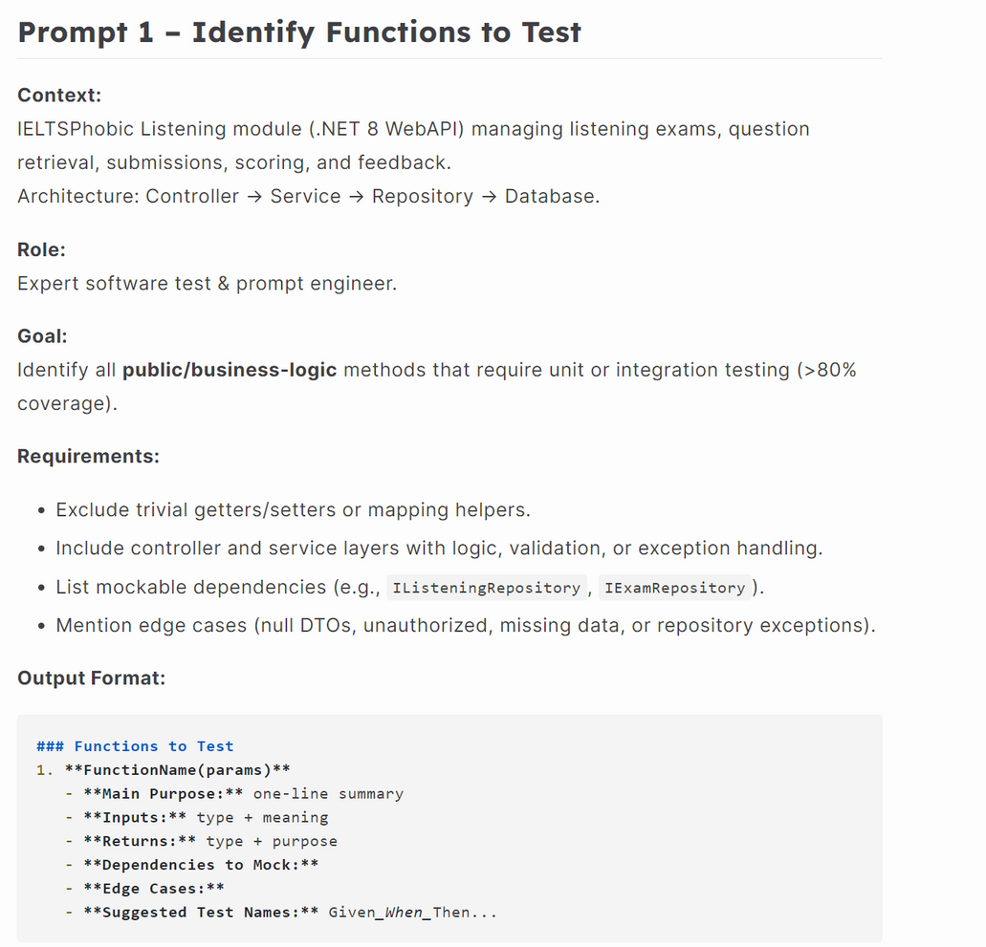
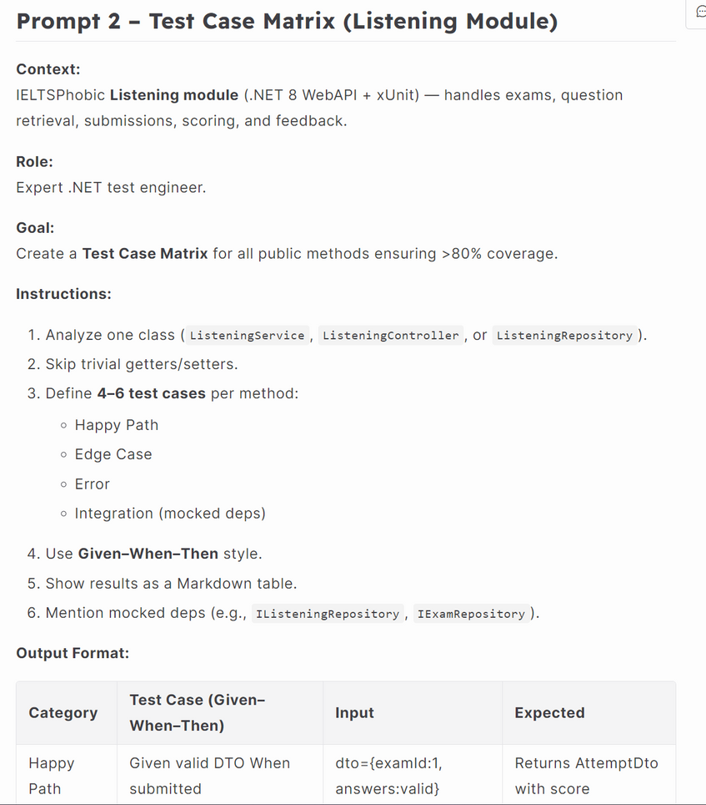
PHASE 2: TEST CASE DESIGN
AI InPut For Listening Service

Slide 15
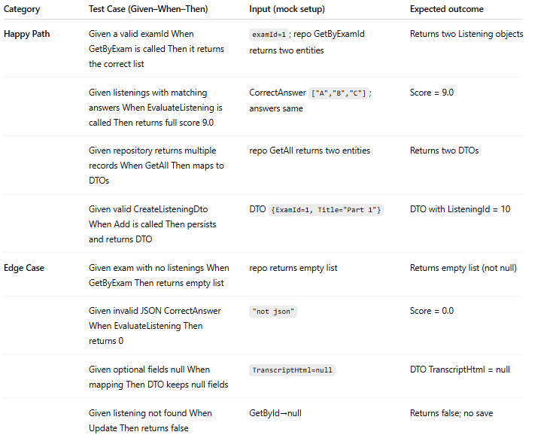
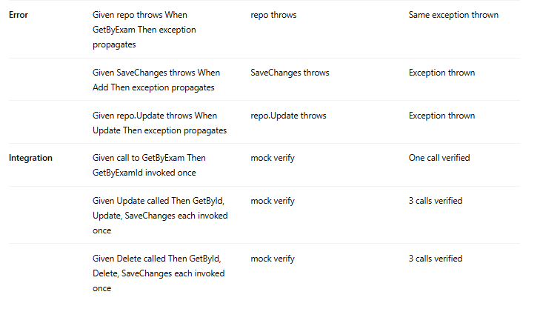
PHASE 2: TEST CASE DESIGN
AI OUTPUT For Listening Service

Slide 16
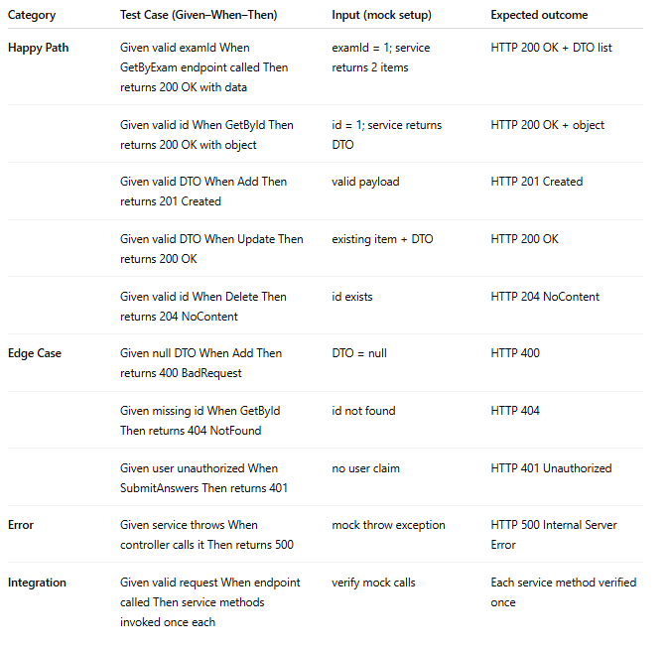
PHASE 2: TEST CASE DESIGN
AI OUTPUT For Listening Controller

Slide 17
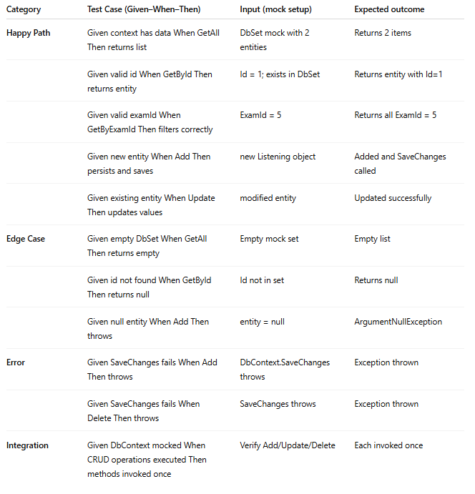
PHASE 2: TEST CASE DESIGN
AI OUTPUT For Listening Repository

Slide 18
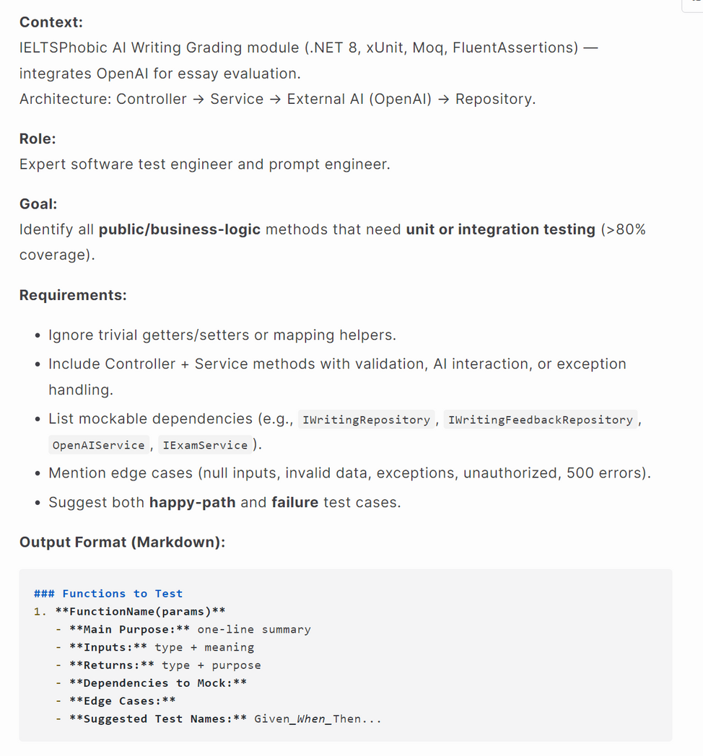
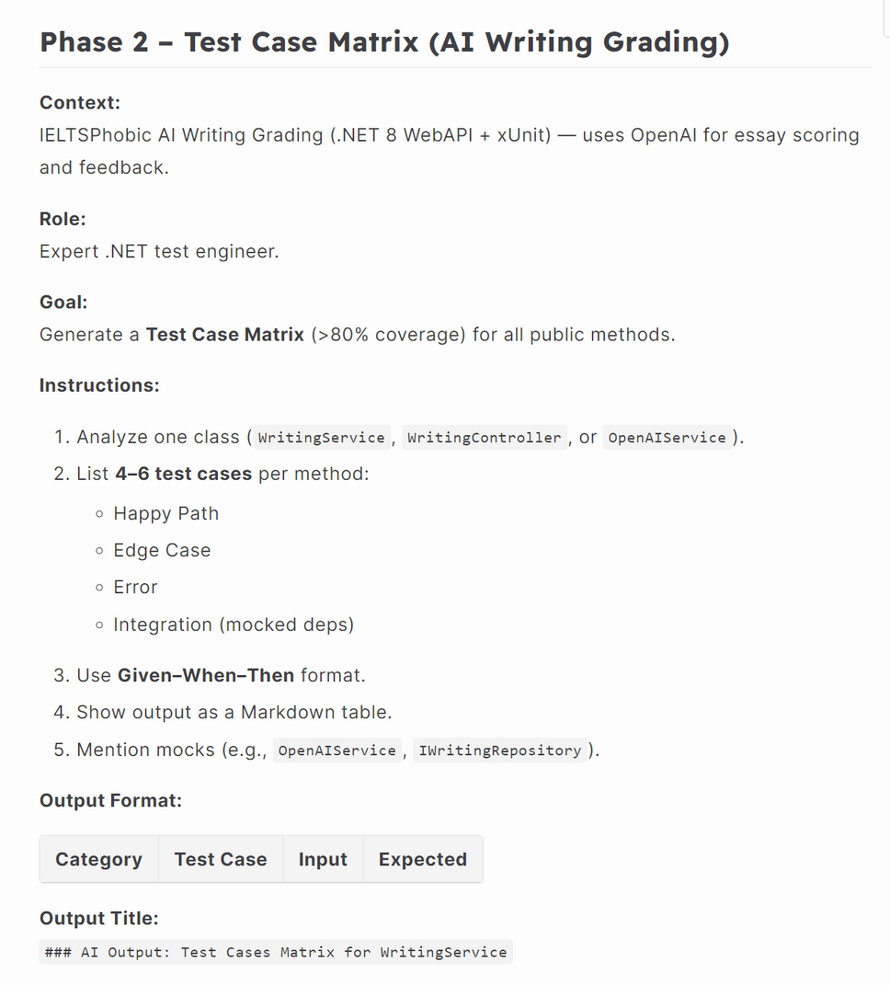
PHASE 2: TEST CASE DESIGN
AI INPUT For Writing Service

Slide 19
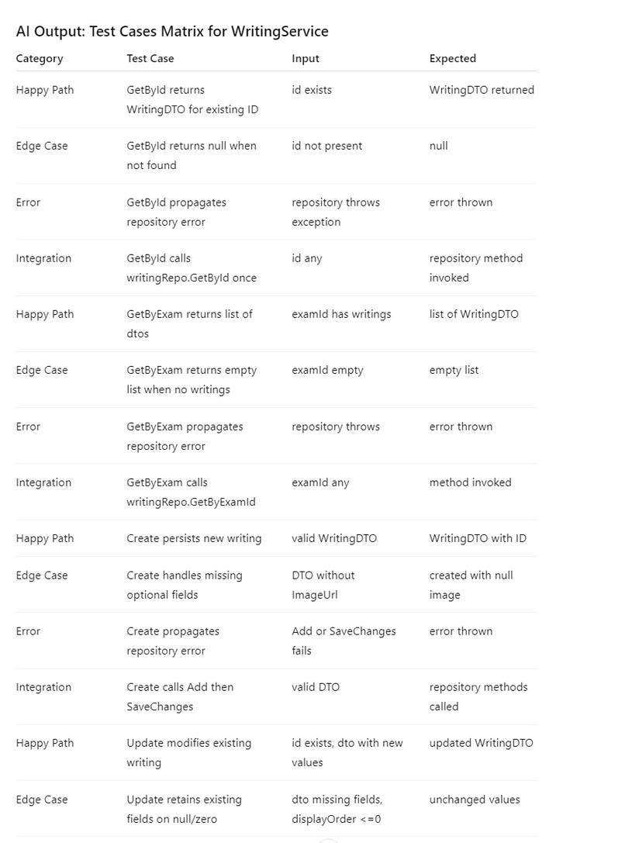
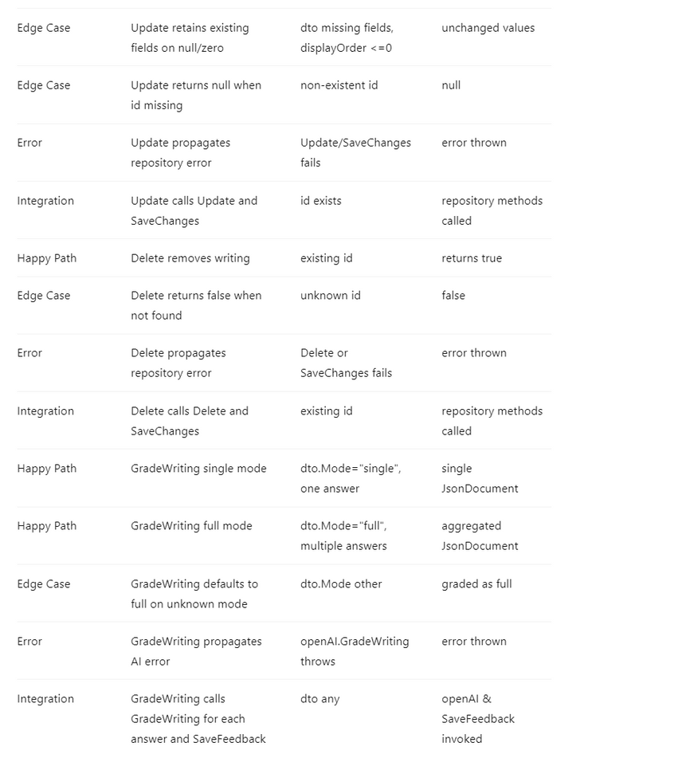
PHASE 2: TEST CASE DESIGN
AI OUTPUT For Writing Service

Slide 20
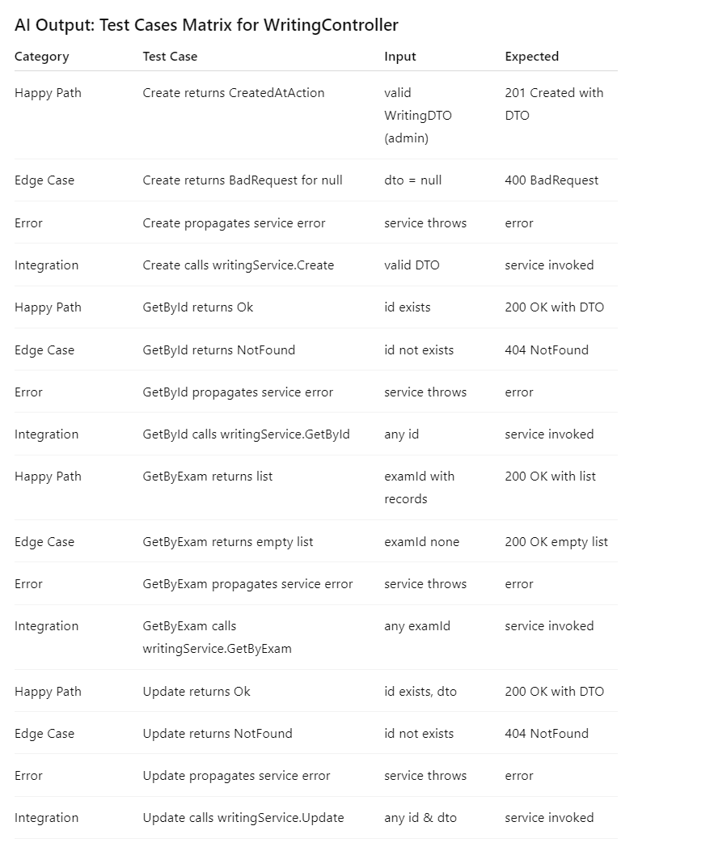
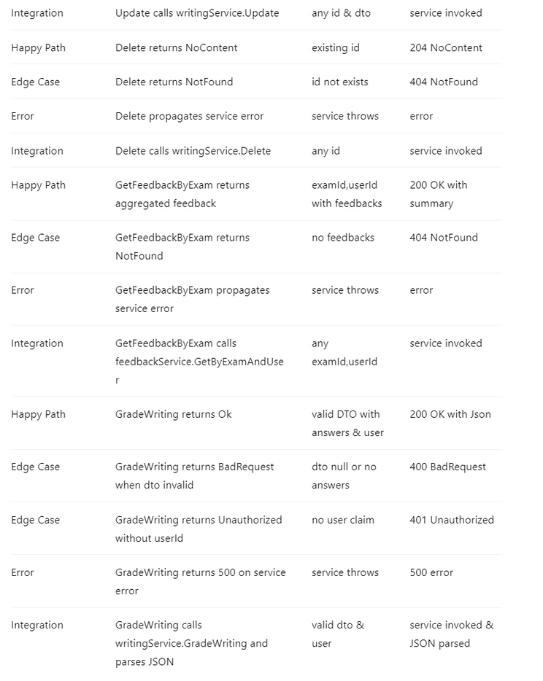
PHASE 2: TEST CASE DESIGN
AI OUTPUT For Writing Controller

Slide 21
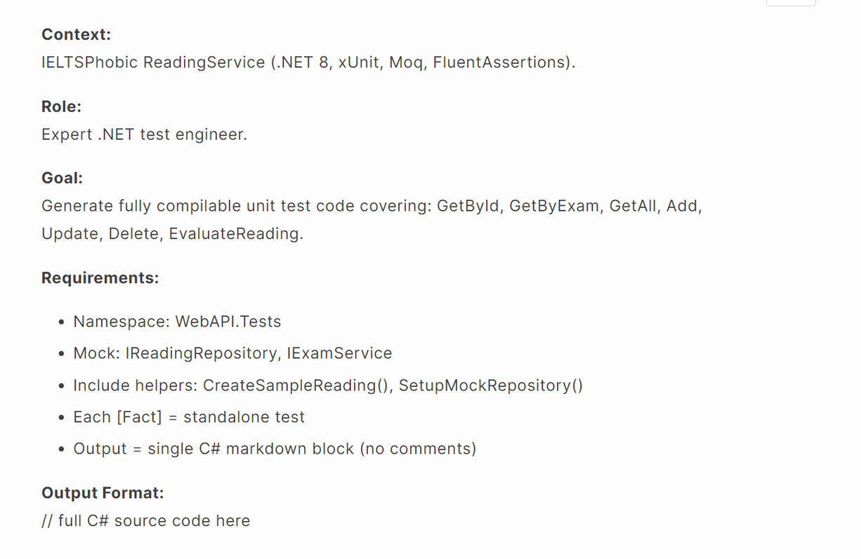
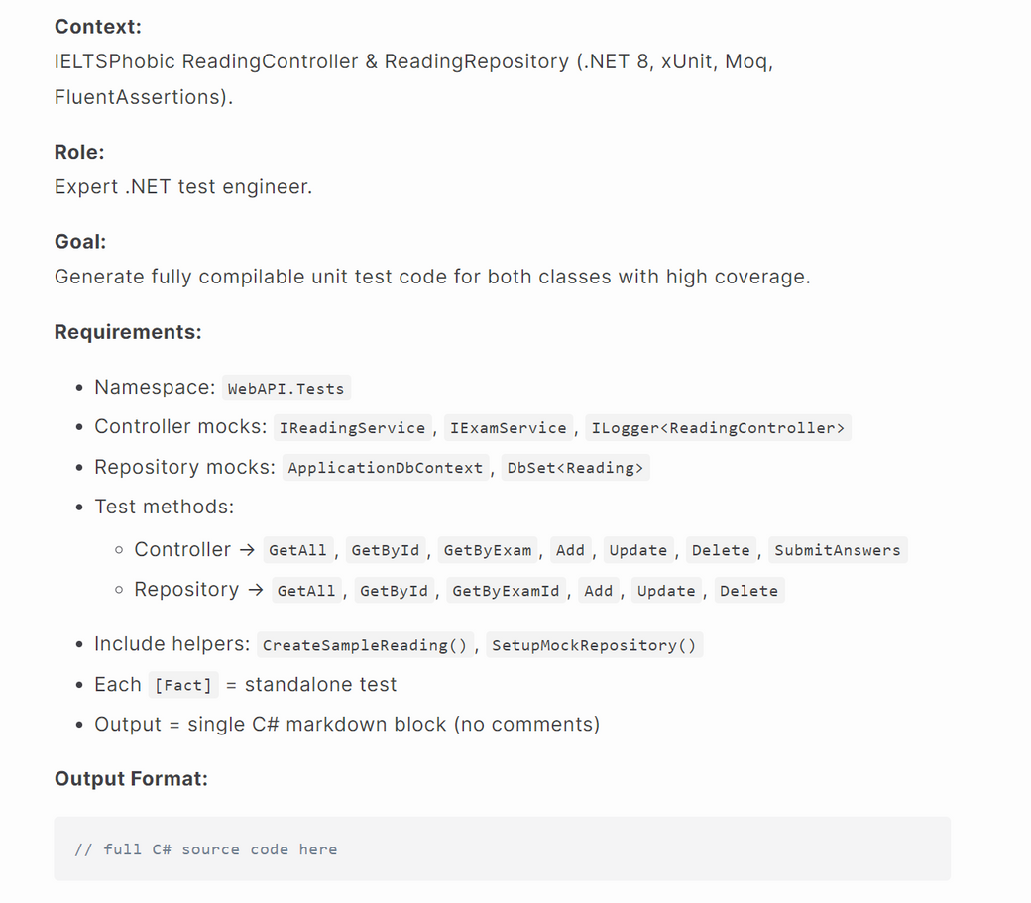

PHASE 3: TEST CODE GENERATION

Slide 22
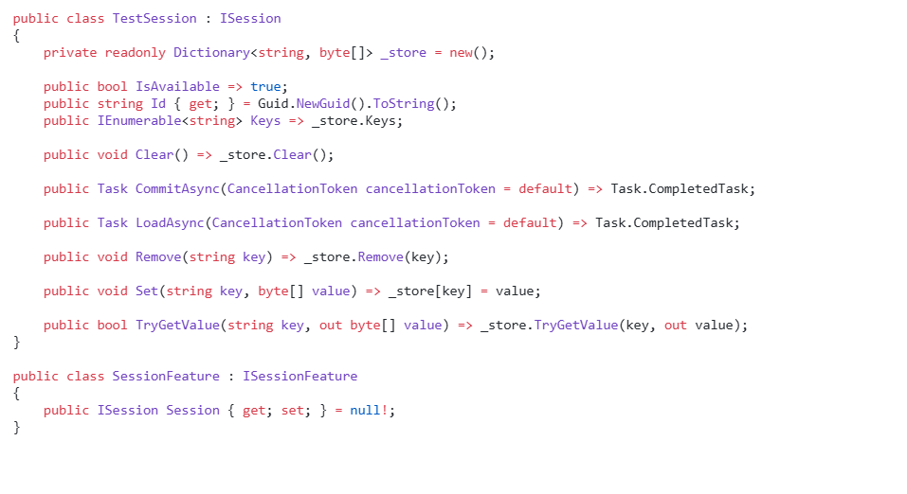
PHASE 3: TEST CODE GENERATION
AI OUTPUT Code For Reading Service

Slide 23
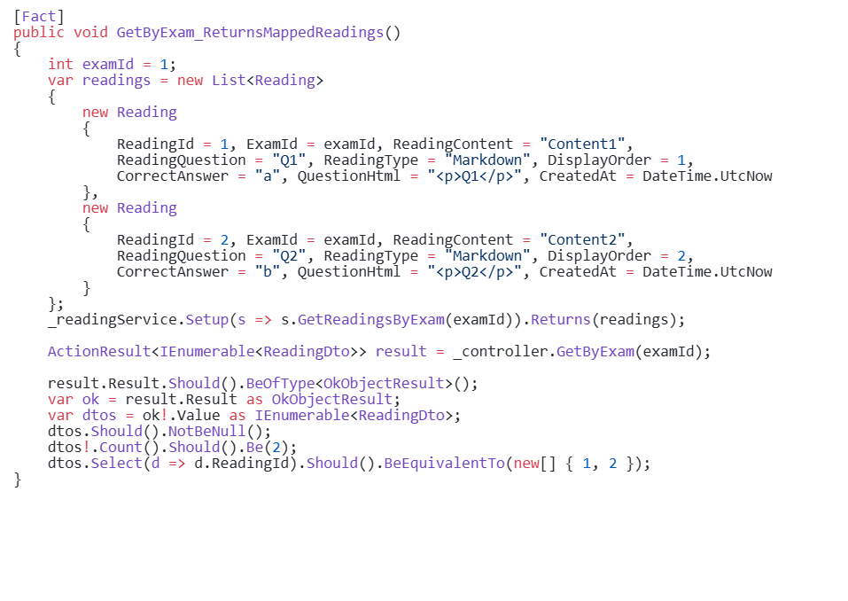
PHASE 3: TEST CODE GENERATION
AI OUTPUT Code For Reading Service

Slide 24
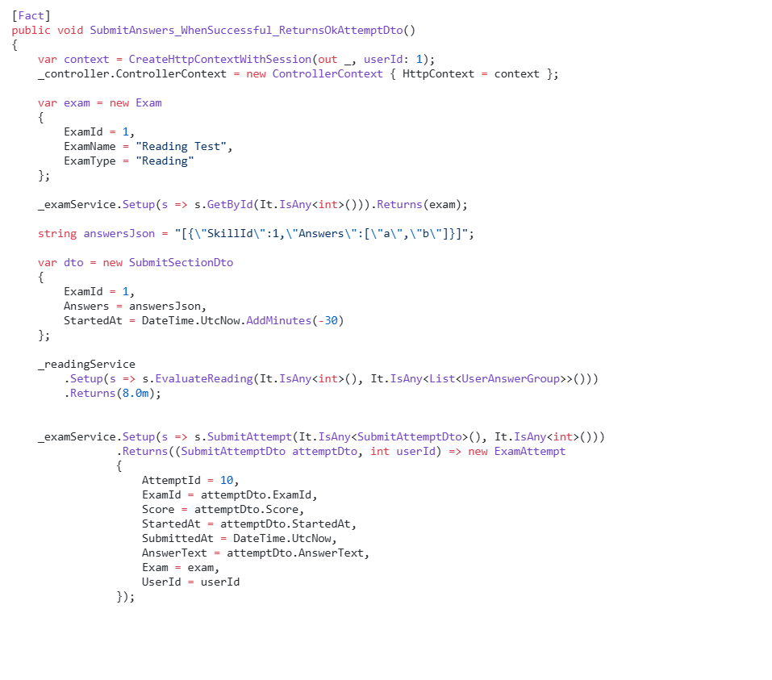
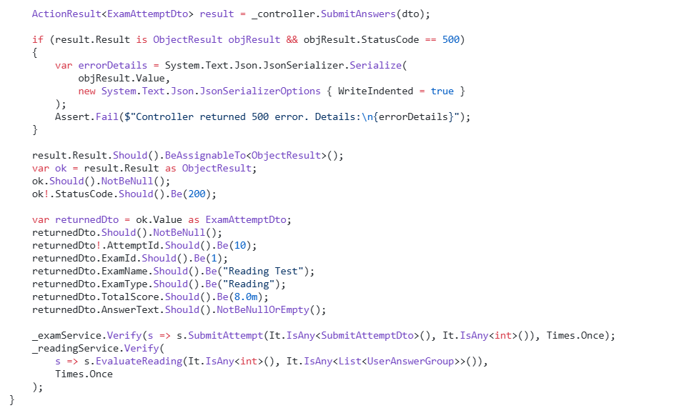
PHASE 3: TEST CODE GENERATION
AI OUTPUT Code For Reading Service

Slide 25
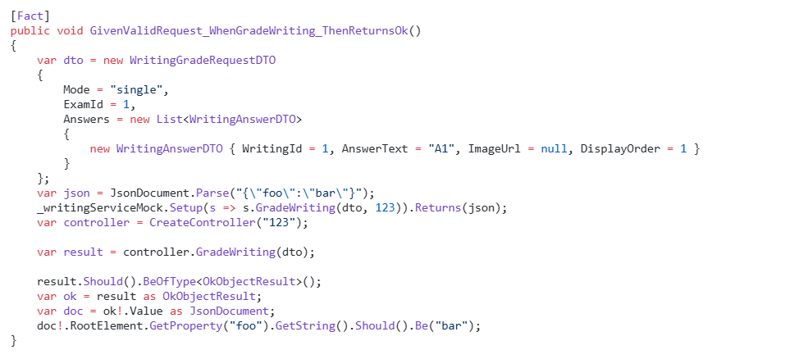
PHASE 3: TEST CODE GENERATION
AI OUTPUT Code For Writing Service

Slide 26
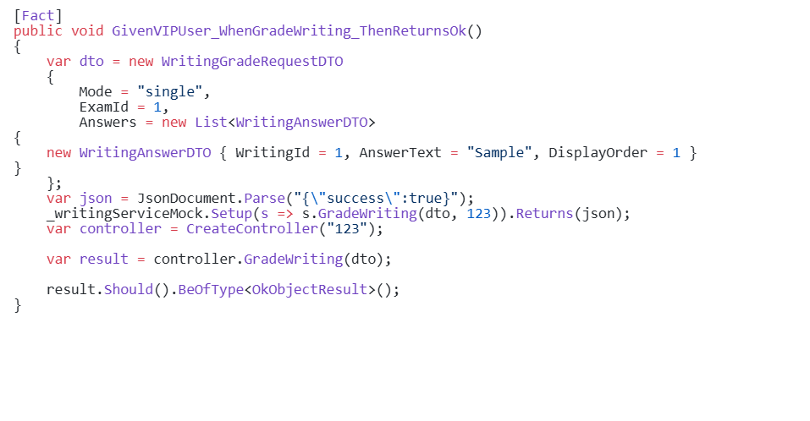
PHASE 3: TEST CODE GENERATION
AI OUTPUT Code For Writing Controller

Slide 27
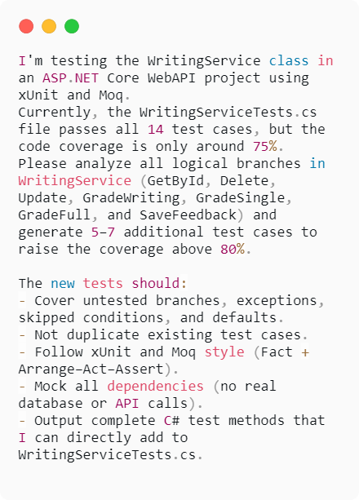
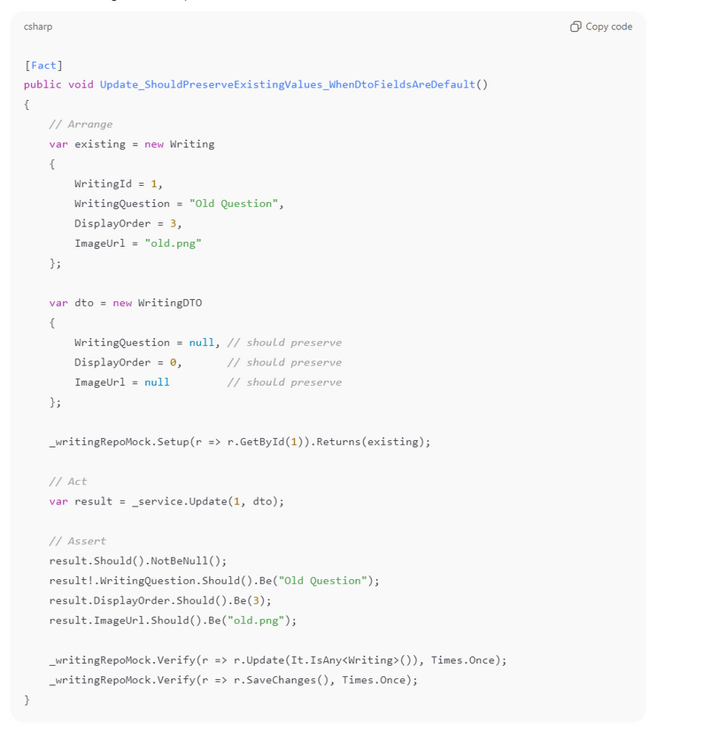
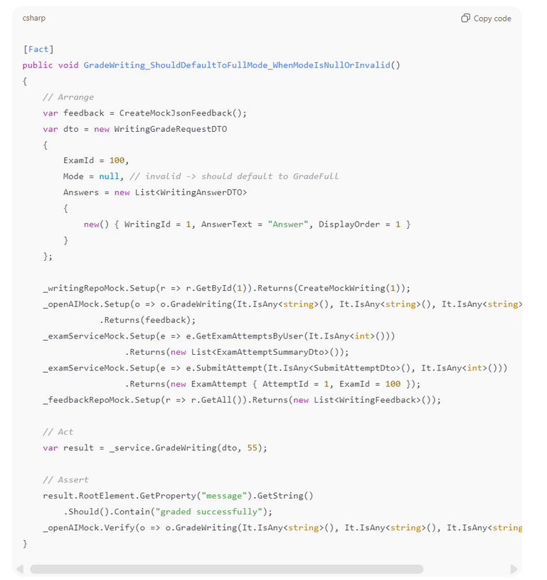
PHASE 4: RUN & DEBUG TESTS

Slide 28
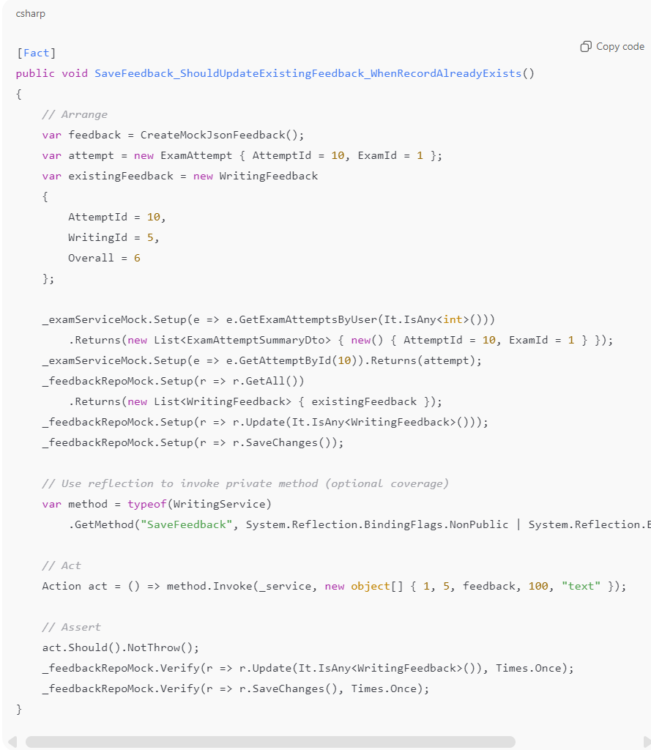
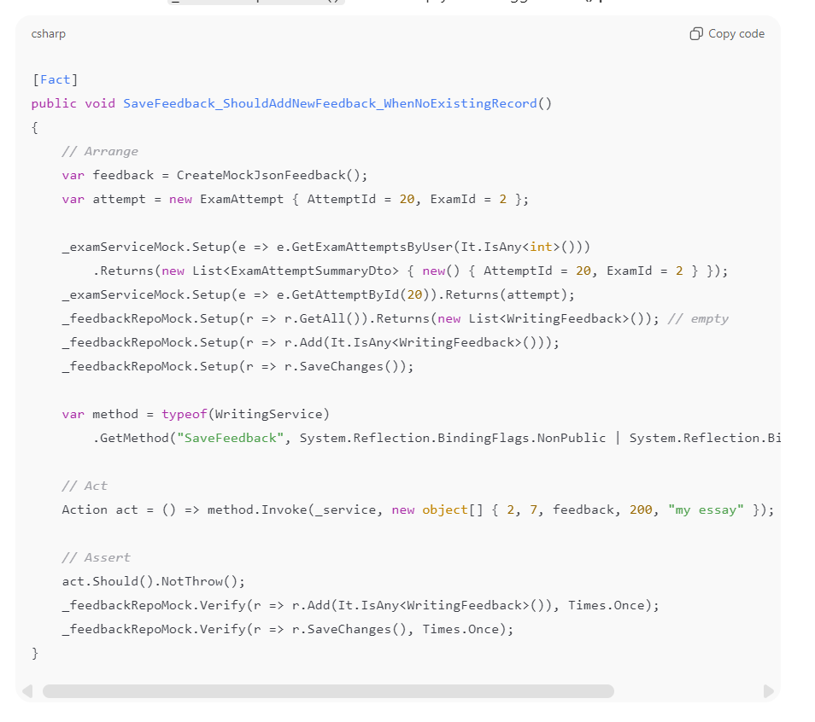
PHASE 4: RUN & DEBUG TESTS

Slide 29

Ingoude Company
Home
Video
Profile
Thank You

